Slide 1
Energy dissipation of waves at the coast
Coastal defence systems

Slide 2
Motivation
Flood risk is increasing due to climate change
Coastal defence systems can prevent flooding by wave overtopping via energy dissipation
Research Question:
What structures are the most effective to dissipate wave energy ?
beach / sloping topographie
offshore barrier (breakwater)

Slide 3
Theory: Shallow water waves
ω = k∗√gh = 2π / λ ∗√gh
→ optimum frequency is where inertia of water is the lowest
𝑐 = √𝑔ℎ
Shallow water waves breaking is limited by amplitude to depth ratio
(𝑎/ℎ)_𝑚𝑎𝑥 = 0.78 [McCowan 1894]

Slide 4
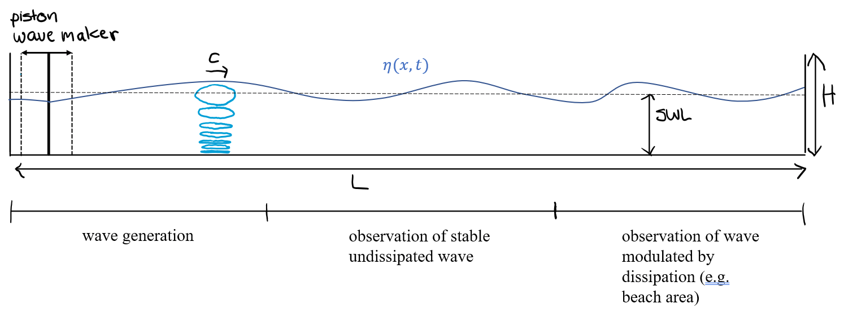

Experimental Setup
Measurement
ideally: velocity field via PIV to obtain energy dissipation rate
Problem: too high velocities?
Wave height spectra, obtain visually (fotos/video), other options?
waves need to travel ~ twice the hinge depth (SWL) of the piston paddle to fully develop
the dissipation area (e.g. sloping beach) must be long enough to have an effect
→ we need a sufficient tank length

Slide 5
NUMERICAL MODEL OBSERVATIONS
Two layers model with a high density jump, force a wave between the layers, problem: incident mixing → does not represent surface waves
Compare to dissipation of internal waves by similar structures (sloping bottom topographie)
Try to implement numerical model designed for surface waves in a tank
Field observations we can compare to:
wave height data at a sloping beach (Elgar et al., 1997)
Prediction of breaking wave height field measurements compared to tank studies (Weishar & Byrne, 1978)
Wave Dissipation by Vegetation (Anderson et al., 2011)

